Slide 1
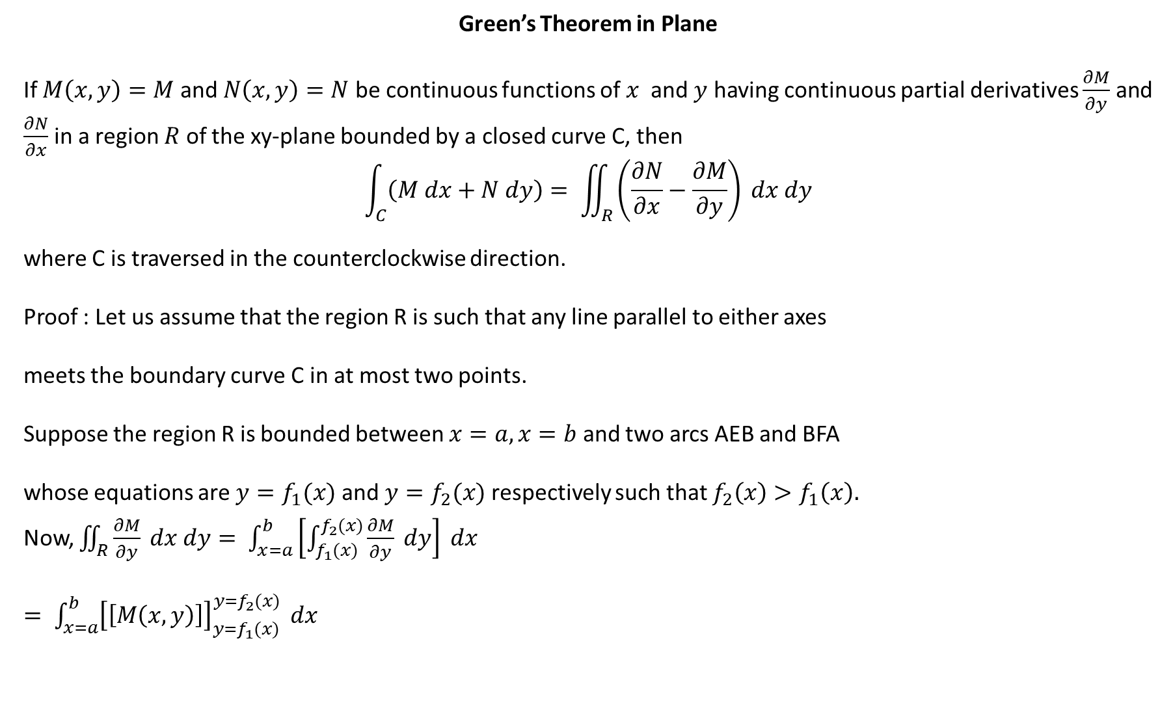
Green’s Theorem in Plane
If $M\left(x,y\right)=M$ and $N\left(x,y\right)=N$ be continuous functions of $x$ and $y$ having continuous partial derivatives $\frac{∂M}{∂y}$ and $\frac{∂N}{∂x}$ in a region $R$ of the xy-plane bounded by a closed curve C, then
$$\int_{C}{\left(M dx+N dy\right)= \iint_{R}{\left(\frac{∂N}{∂x}−\frac{∂M}{∂y}\right) dx dy}}$$
where C is traversed in the counterclockwise direction.
Proof : Let us assume that the region R is such that any line parallel to either axes
meets the boundary curve C in at most two points.
Suppose the region R is bounded between $x=a, x=b$ and two arcs AEB and BFA
whose equations are $y=f_{1}(x)$ and $y=f_{2}(x)$ respectively such that $f_{2}\left(x\right)>f_{1}\left(x\right).$
Now, $\iint_{R}{\frac{∂M}{∂y} dx dy= \int_{x=a}^{b}{\left[\int_{f_{1}(x)}^{f_{2}(x)}{\frac{∂M}{∂y} dy}\right] dx}}$
$= \int_{x=a}^{b}{{\left[\left[M\left(x,y\right)\right]\right]}_{y=f_{1}(x)}^{y=f_{2}(x)}} dx$
Y
$$y=f_{2}(x)$$
B
F
R
E
A
$$y=f_{1}(x)$$
$$x=a$$
$$x=b$$
O
X

Slide 2
$= \int_{a}^{b}{\left[M\left(x,f_{2}\right)−M\left(x,f_{1}\right)\right]dx}$
$= \int_{a}^{b}{M\left(x,f_{2}\right)dx− \int_{a}^{b}{M\left(x, f_{1}\right)dx=− }}\int_{b}^{a}{M\left(x,f_{2}\right)dx− \int_{a}^{b}{M\left(x, f_{1}\right)dx }}$
$= −[\int_{b}^{a}{M\left(x,f_{2}\right)dx+ \int_{a}^{b}{M\left(x, f_{1}\right)dx ]=− \int_{C}{M dx}}}$
$∴\int_{C}{M dx}=−\iint_{R}{\frac{∂M}{∂y} dx dy}$ …………. (1)
Similarly , taking the region R is bounded between $y=c, y=d$ and two arcs AEB and BFA
whose equations are $x=f_{1}(y)$ and $x=f_{2}(y)$ respectively such that $f_{2}\left(y\right)>f_{1}\left(y\right)$, as shown in figure, we get
$\int_{C}{N dy}=\iint_{R}{\frac{∂N}{∂X} dx dy}$ …………. (2)
Adding (1) and (2)
$\int_{C}{\left(M dx+N dy\right)= \iint_{R}{\left(\frac{∂N}{∂x}−\frac{∂M}{∂y}\right) dx dy}}$ , as desired.
$$y=d$$
B
F
$$x=f_{1}(y)$$
R
E
$$y=c$$
A
$$x=f_{2}(y)$$

Slide 3
Moreover if a line parallel to the axes meets the curve in more than two points , we divide the region into in a finite number of sub-regions in which the condition imposed in the beginning of the proof meets. We add the result for all such sub-regions and prove the theorem.
Area using Green’s theorem
The area enclosed by a simple closed curve is given by,
$$A=\frac{1}{2} \int_{C}{(x dy−ydx)}$$
Proof : We have Green’s theorem in plane, $\int_{C}{\left(M dx+N dy\right)= \iint_{R}{\left(\frac{∂N}{∂x}−\frac{∂M}{∂y}\right) dx dy}}$
Choosing $M=−y$ and $N=x$ , $\int_{C}{(x dy−ydx)}=\iint_{R}{\left(\frac{∂x}{∂x}−\frac{∂(−y)}{∂y}\right) dx dy}=\iint_{R}{2 dx dy}=2A$
$∴A=\frac{1}{2} \int_{C}{(x dy−ydx)}$

Slide 4



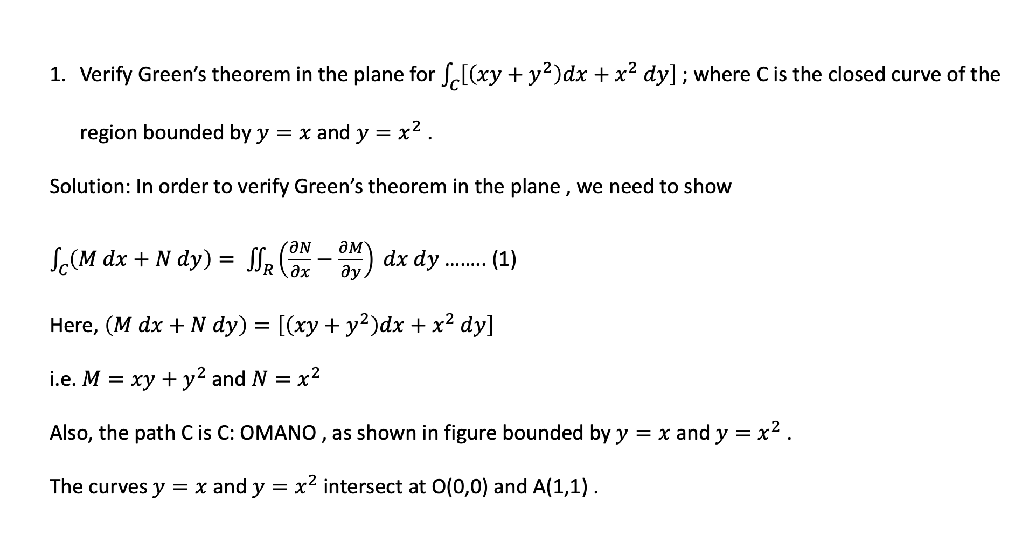


Verify Green’s theorem in the plane for $\int_{C}{\left[\left(xy+y^{2}\right)dx+x^{2} dy\right]}$ ; where C is the closed curve of the region bounded by $y=x$ and $y=x^{2}$ .
Solution: In order to verify Green’s theorem in the plane , we need to show
$\int_{C}{\left(M dx+N dy\right)= \iint_{R}{\left(\frac{∂N}{∂x}−\frac{∂M}{∂y}\right) dx dy}}$ …….. (1)
Here, $\left(M dx+N dy\right)=\left[\left(xy+y^{2}\right)dx+x^{2} dy\right]$
i.e. $M=xy+y^{2}$ and $N=x^{2}$
Also, the path C is C: OMANO , as shown in figure bounded by $y=x$ and $y=x^{2}$ .
The curves $y=x$ and $y=x^{2}$ intersect at O(0,0) and A(1,1) .
$$y=x$$
$$y=x^{2}$$
A$(1,1)$
$$N$$
$$M$$
$$O(0,0)$$

Slide 5
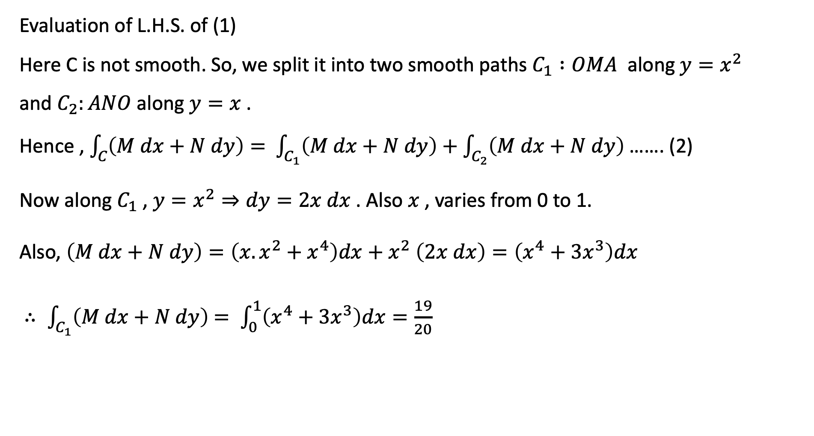
Evaluation of L.H.S. of (1)
Here C is not smooth. So, we split it into two smooth paths $C_{1} :OMA$ along $y=x^{2}$
and $C_{2}:ANO$ along $y=x$ .
Hence , $\int_{C}{\left(M dx+N dy\right)= }$ $\int_{C_{1}}{\left(M dx+N dy\right)+\int_{C_{2}}{\left(M dx+N dy\right) }}$……. (2)
Now along $C_{1}$ , $y=x^{2}⇒dy=2x dx$ . Also $x$ , varies from 0 to 1.
Also, $\left(M dx+N dy\right)=\left(x.x^{2}+x^{4}\right)dx+x^{2} \left(2x dx\right)=\left(x^{4}+3x^{3}\right)dx$
$∴ \int_{C_{1}}{\left(M dx+N dy\right)}$ $= \int_{0}^{1}{\left(x^{4}+3x^{3}\right)dx=\frac{19}{20} }$

Slide 6
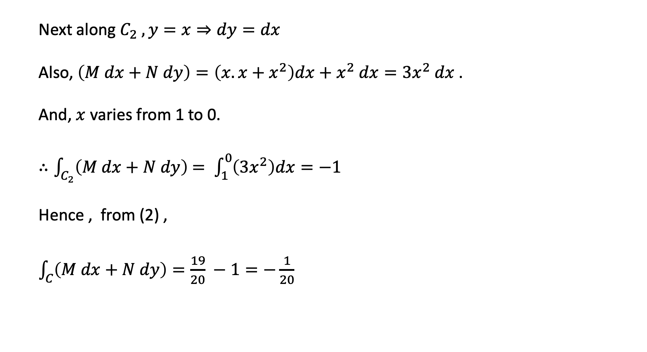
Next along $C_{2} , y=x⇒dy=dx$
Also, $\left(M dx+N dy\right)=\left(x.x+x^{2}\right)dx+x^{2} dx=3x^{2} dx$ .
And, $x$ varies from 1 to 0.
$∴\int_{C_{2}}{\left(M dx+N dy\right)}$ $= \int_{1}^{0}{\left(3x^{2}\right)dx=−1 }$
Hence , from (2) ,
$\int_{C}{\left(M dx+N dy\right)=\frac{19}{20} −1=−\frac{1}{20} }$

Slide 7
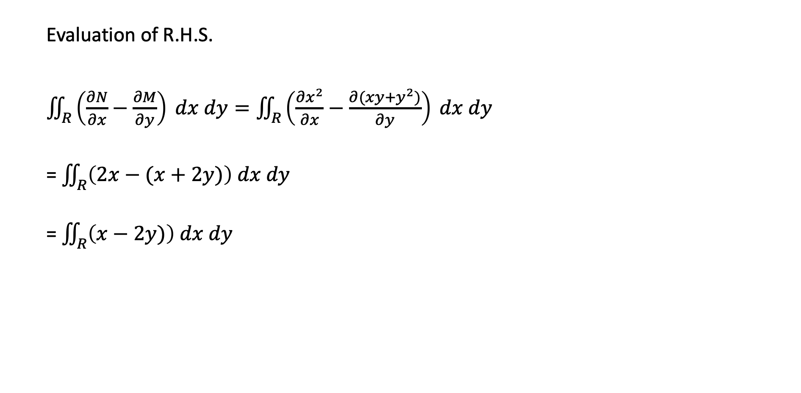
Evaluation of R.H.S.
$\iint_{R}{\left(\frac{∂N}{∂x}−\frac{∂M}{∂y}\right) dx dy}=\iint_{R}{\left(\frac{∂x^{2}}{∂x}−\frac{∂(xy+y^{2})}{∂y}\right) dx dy}$
= $\iint_{R}{\left(2x−(x+2y)\right) dx dy}$
= $\iint_{R}{\left(x−2y)\right) dx dy}$

Slide 8

= $\int_{0}^{1}{\left[\int_{y=x^{2}}^{x}{\left(x−2y\right)dy}\right]dx}$
= $\int_{0}^{1}{{\left[xy−y^{2}\right]}_{y=x^{2}}^{x}} dx$
= $\int_{0}^{1}{\left(x^{4}−x^{3}\right)dx}$
= $−\frac{1}{20}$
$∵$ L.H.S. = R.H.S , hence the theorem is verified.

Slide 9

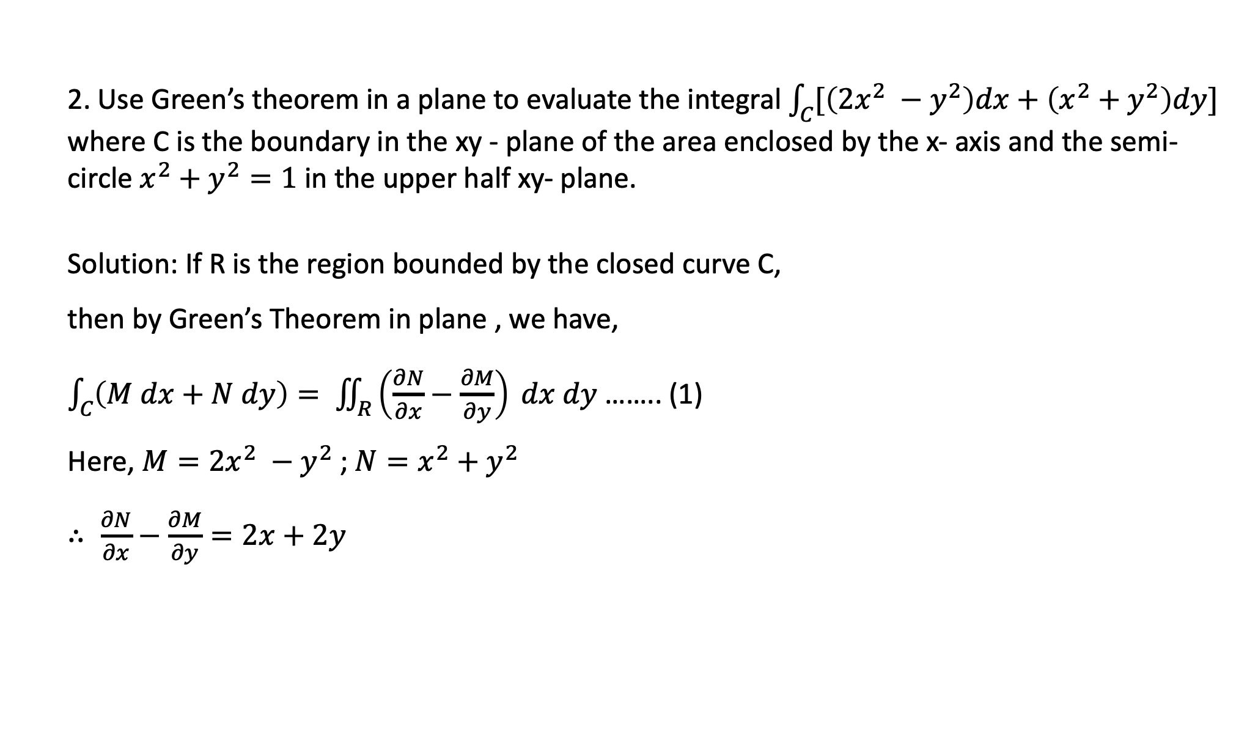
2. Use Green’s theorem in a plane to evaluate the integral $\int_{C}{[\left(2x^{2} −y^{2}\right)dx+\left(x^{2}+y^{2}\right)dy]}$ where C is the boundary in the xy - plane of the area enclosed by the x- axis and the semi- circle $x^{2}+y^{2}=1$ in the upper half xy- plane.
Solution: If R is the region bounded by the closed curve C,
then by Green’s Theorem in plane , we have,
$\int_{C}{\left(M dx+N dy\right)= \iint_{R}{\left(\frac{∂N}{∂x}−\frac{∂M}{∂y}\right) dx dy}}$ …….. (1)
Here, $M=2x^{2} −y^{2}$ ; $N=x^{2}+y^{2}$
$∴ \frac{∂N}{∂x}−\frac{∂M}{∂y}=2x+2y$
Y
C: semi circle $x^{2}+y^{2}=1$
R
B (-1,0)
O
A (1,0)
X

Slide 10

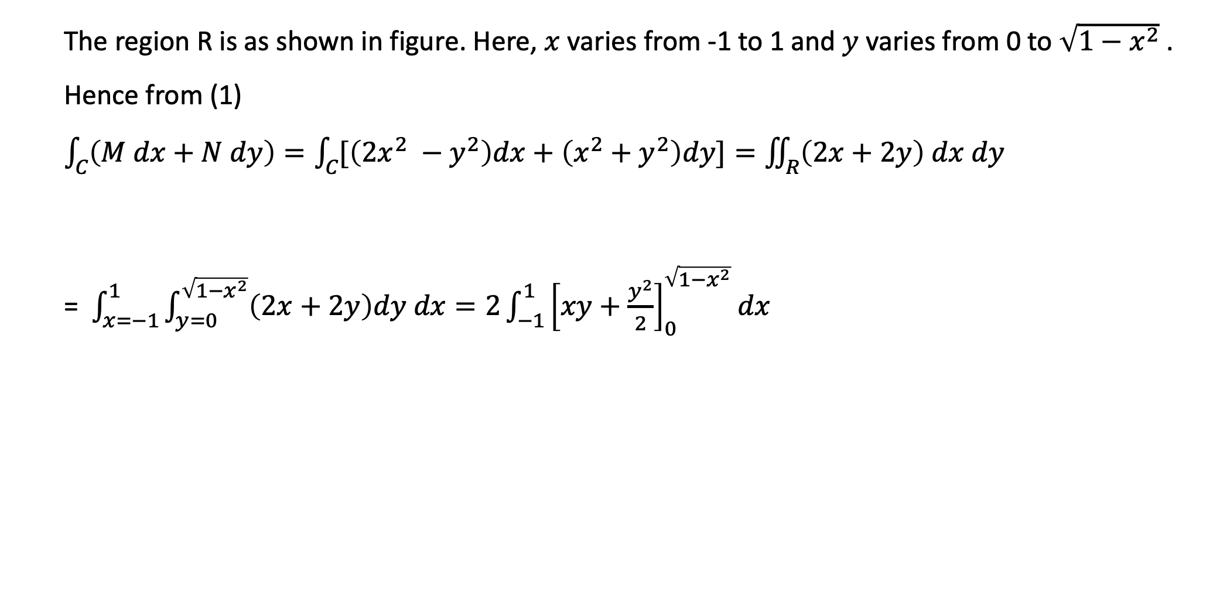
The region R is as shown in figure. Here, $x$ varies from -1 to 1 and $y$ varies from 0 to $\sqrt{1−x^{2}}$ .
Hence from (1)
$\int_{C}{\left(M dx+N dy\right)=\int_{C}{[\left(2x^{2} −y^{2}\right)dx+\left(x^{2}+y^{2}\right)dy]}=\iint_{R}{\left(2x+2y\right) dx dy}}$
= $\int_{x=−1}^{1}{\int_{y=0}^{\sqrt{1−x^{2}}}{\left(2x+2y\right)dy dx=2\int_{−1}^{1}{{\left[xy+\frac{y^{2}}{2}\right]}_{0}^{\sqrt{1−x^{2}}}dx }}}$
Y
C: semi circle $x^{2}+y^{2}=1$
B (-1,0)
O
A (1,0)
X

Slide 11

= $2 \int_{−1}^{1}{[x\sqrt{1−x^{2} }}+\frac{1}{2} (1−x^{2})] dx$
= $\int_{−1}^{1}{\left(1−x^{2}\right)dx}$ ; [ $∵ \int_{−1}^{1}{x \sqrt{1−x^{2}}} dx=0$ ]
= $\frac{4}{3}$
Exercise : Using Green’s theorem in plane, evaluate $\int_{C}{\left[\left(2x−y+4\right)dx+\left(5y+3x−6\right)dy\right]}$ around a circle C of radius 4 with center at origin.

Slide 12
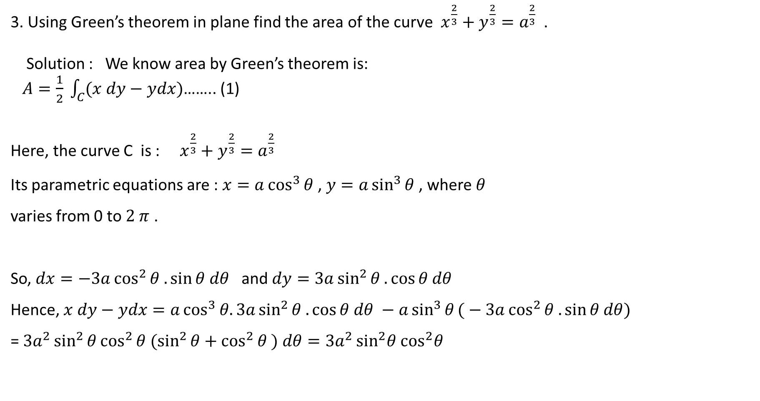
3. Using Green’s theorem in plane find the area of the curve $x^{\frac{2}{3}}+y^{\frac{2}{3}}=a^{\frac{2}{3}}$ .
Solution : We know area by Green’s theorem is:
$A=\frac{1}{2} \int_{C}{(x dy−ydx)}$…….. (1)
Here, the curve C is : $x^{\frac{2}{3}}+y^{\frac{2}{3}}=a^{\frac{2}{3}}$
Its parametric equations are : $x=a\cos^{3}{θ}$ , $y=a\sin^{3}{θ}$ , where $θ$
varies from 0 to $2 π$ .
So, $dx=−3a\cos^{2}{θ .\sin{θ dθ}}$ and $dy=3a\sin^{2}{θ .\cos{θ dθ}}$
Hence, $x dy−ydx=a\cos^{3}{θ.3a\sin^{2}{θ .\cos{θ dθ}} −a\sin^{3}{θ}(}−3a\cos^{2}{θ .\sin{θ dθ}})$
= $3a^{2}\sin^{2}{θ\cos^{2}{θ (\sin^{2}{θ+\cos^{2}{θ ) dθ=3a^{2}}}}}\sin^{2}θ$ $\cos^{2}θ$
$$x^{\frac{2}{3}}+y^{\frac{2}{3}}=a^{\frac{2}{3}}$$

Slide 13

Hence from (1), $A=\frac{1}{2} \int_{C}{(x dy−ydx)}$= $\frac{3}{2} a^{2} \int_{0}^{2π}{\sin^{2}θ \cos^{2}θ dθ}$
= $\frac{3}{ 8} a^{2}$ $\int_{0}^{2π}{\sin^{2}{2}θ dθ}$ = $\frac{3}{ 16} a^{2}$ $\int_{0}^{2π}{(1−\cos{4θ)}dθ}$
= $\frac{3}{ 16} a^{2} {\left[θ−\frac{\sin{4θ}}{4}\right]}_{0}^{2π}$= $\frac{3}{ 16} a^{2} × 2π$
= $\frac{3}{ 8} {πa}^{2}$ square unit

Slide 14
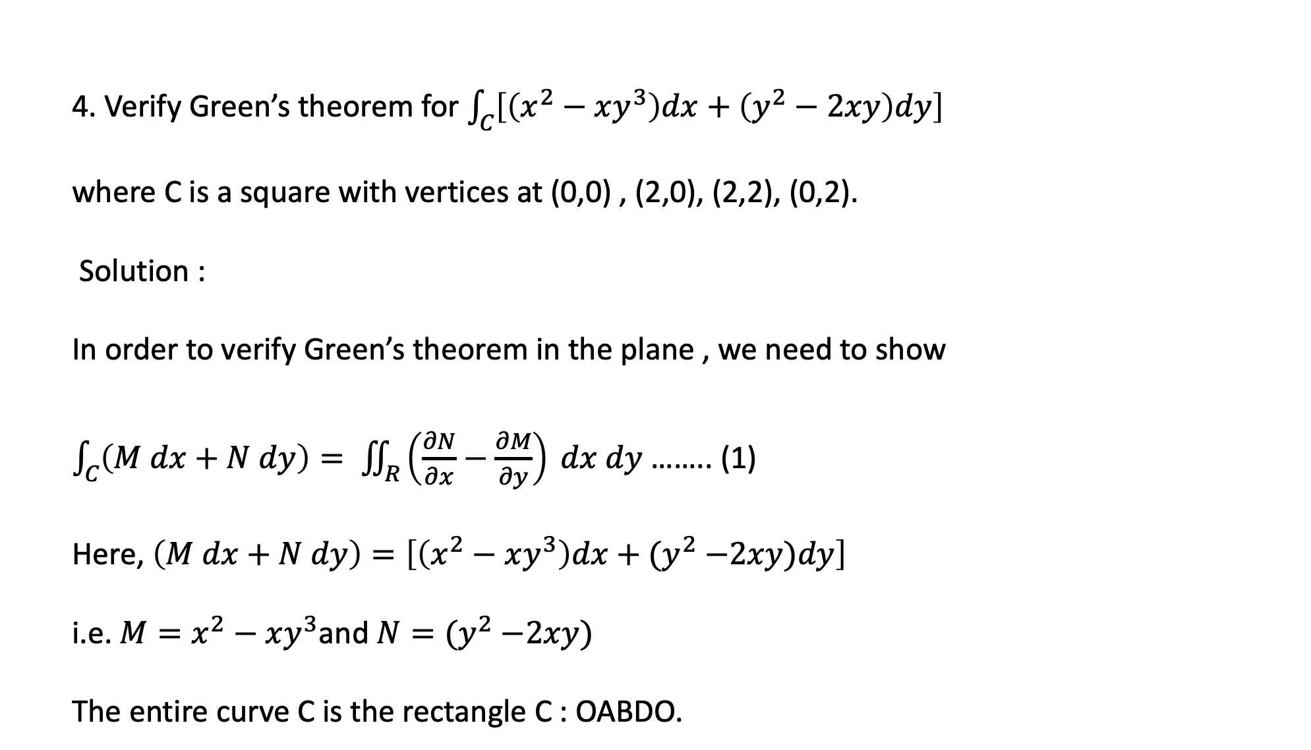
4. Verify Green’s theorem for $\int_{C}{\left[\left(x^{2}−xy^{3}\right)dx+\left(y^{2}−2xy\right)dy\right]}$
where C is a square with vertices at (0,0) , (2,0), (2,2), (0,2).
Solution :
In order to verify Green’s theorem in the plane , we need to show
$\int_{C}{\left(M dx+N dy\right)= \iint_{R}{\left(\frac{∂N}{∂x}−\frac{∂M}{∂y}\right) dx dy}}$ …….. (1)
Here, $\left(M dx+N dy\right)=\left[\left(x^{2}−xy^{3}\right)dx+{(y}^{2} −2xy)dy\right]$
i.e. $M=x^{2}−xy^{3}$and $N={(y}^{2} −2xy)$
The entire curve C is the rectangle C : OABDO.
Y
$$y=2$$
B(2,2)
D(0,2)
$$x=0$$
$$x=2$$
$$y=0$$
X
O(0,0)
A(2,0)

Slide 15
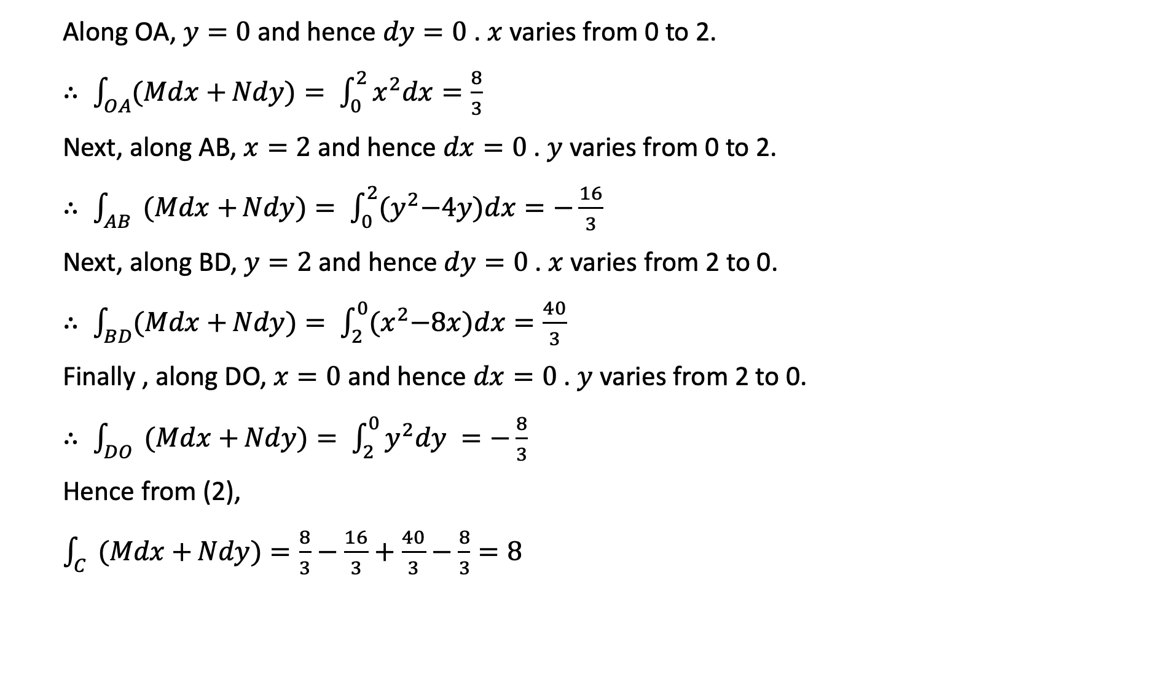
Along OA, $y=0$ and hence $dy=0$ . $x$ varies from 0 to 2.
$∴ \int_{OA}{(Mdx+}Ndy)= \int_{0}^{2}{x^{2}dx=\frac{8}{3}}$
Next, along AB, $x=2$ and hence $dx=0$ . $y$ varies from 0 to 2.
$∴ \int_{AB}{ (Mdx+}Ndy)= \int_{0}^{2}{{(y}^{2}−4y)dx=−\frac{16}{3}}$
Next, along BD, $y=2$ and hence $dy=0$ . $x$ varies from 2 to 0.
$∴ \int_{BD}{(Mdx+}Ndy)= \int_{2}^{0}{{(x}^{2}−8x)dx=\frac{40}{3}}$
Finally , along DO, $x=0$ and hence $dx=0$ . $y$ varies from 2 to 0.
$∴ \int_{DO}{ (Mdx+}Ndy)= \int_{2}^{0}{y^{2}dy =−\frac{8}{3}}$
Hence from (2),
$\int_{C}{ (Mdx+}Ndy)=\frac{8}{3}−\frac{16}{3}+\frac{40}{3}−\frac{8}{3}=8$

Slide 16
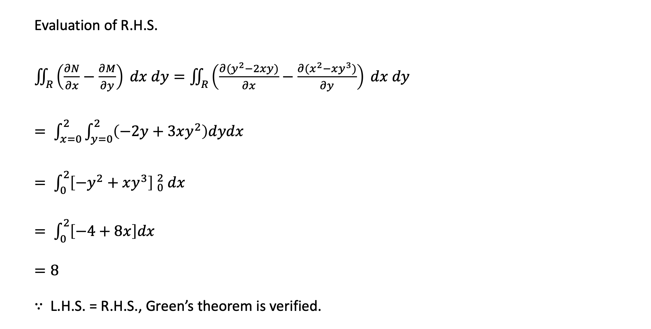
Evaluation of R.H.S.
$\iint_{R}{\left(\frac{∂N}{∂x}−\frac{∂M}{∂y}\right) dx dy}=\iint_{R}{\left(\frac{∂(y^{2}−2xy)}{∂x}−\frac{∂(x^{2}−xy^{3})}{∂y}\right) dx dy}$
$= \int_{x=0}^{2}{\int_{y=0}^{2}{\left(−2y+3xy^{2}\right)dydx}}$
$= \int_{0}^{2}{{\left[−y^{2}+xy^{3}\right] }_{0}^{2} dx}$
$= \int_{0}^{2}{\left[−4+8x\right]dx}$
$=8$
$∵$ L.H.S. = R.H.S., Green’s theorem is verified.

